Slide 1
Open source ‘Splunk’ applied to QA
By Manish Sapariya
manish.sapariya@kpoint.com
@manishsapariya

Slide 2
who am I
Architect at kPoint Technologies Pvt Ltd.
kPoint :
Platform for creating videos easily which are deeply searchable
Distribute and track the usage of videos
Training, video based customer self service are some of use cases
Primary responsibilities are Testing of kPoint and managing kPoint services cloud.

Slide 3
Talk at glance
What is Splunk/Logstash(aka ELK stack)?
Brief of ELK stack
kPoint’s use case of ELK
Why use ELK in QA
Challenges in internalizing it in QA team
QA related ELK dashboards
How is it benefitting
ELK as debugging tool

Slide 4
What is Splunk/Logstash
Splunk
Log management tool
Gives lots of insight into operations/security and other monitoring aspect from the logs
Proprietary and costly for small business/startups
Logstash / ELK stack
Log management tool/stack
No out of the box report/dashboard
Can be configured to build splunk like tool
Free/Open source
Great community

Slide 5
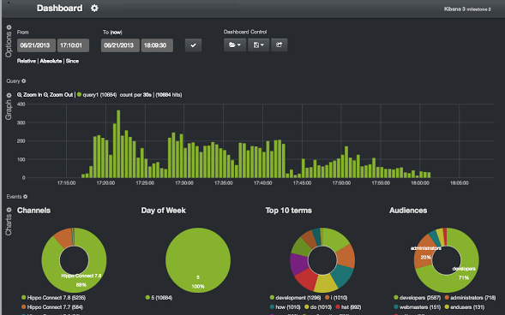
ELK Stack
Logstash input/Indexer
Logstash forwarder
Elasticsearch index store
Kibana
Web
Central log management server

Slide 6
kPoint’s use case of ELK
Started with
Extract business metric from logs
Today, using for
Central dashboard for business metric from log and DB
System performance metric from logs
Central console for debugging production issues
Monitoring specific ERROR reports
In QA
Go to tool for debugging problems
Get insights into problems which do not have visible impact

Slide 7
Why use ELK stack in QA
Started with metric monitoring
Used it for production problem debugging
Tool got widely adapted various kPoint teams
Need for making sure the ELK implementation is not regressing
It was obvious to leverage it in QA cycles

Slide 8
Challenges
Initial resistance to adopt the new tool
simple google like search box was not enough
Created dedicated dashboard to monitor various type of information
One central server or individual ELK instance?
Central ELK server for pre-staging server
Optimized local installation on individual dev/QA VMs
Getting dev to sprinkle enough information in the logs
spec/test case reviews, to ensure specific signatures
More signatures are added during the QA cycle

Slide 9
Typical QA dashboard
One dashboard for each new feature in current sprint
expected error signatures
signatures which are fixed as part of bug fixes
feature usage metric (gives rough idea of coverage)
Global dashboard
Error/Exceptions/Warning count
HTTPD access log
SQL Slow query logs
Daemon/cron job monitor
Backup job ran, how long did it take

Slide 10
Benefits
Monitoring infrastructure is also getting tested in QA cycles
One place to debug problems
no more ssh/vi/grep/awk
Dev/QA are more aware of good log signatures
Very critical to track/debug production issues
Nightly system jobs are verified
Lots of insight about system behavior from the trend data

Slide 11
ELK as debugging tool
Poor man’s profiling tool, with least effort
Profile XML-RPC chattiness using justniffer
Very helpful for plain text protocols like http/smtp/mysql and so on
Profile processes using strace/ps/top
System monitoring dashboard
Send sar data to logstash to get system usage stats
Very useful if you do not have munin/collectd
Analyze volumes of mysql queries using tools like mysqlsniffer

Slide 12

What do default ELLK configuration gives me?

Slide 13
How to identify application specific logs in ELK?

Slide 14
How does ELK manage/store/index logs from different log files?

Slide 15
What kind of APIs are provided by ELK stack?

Slide 16
What kind of default dashboards are provided by Splunk?

Slide 17
What kind of computation/co-relation I can do using ELK?

Slide 18
What is ElasticSearch? / How does ElasticSearch work?

Slide 19
Can I debug SSL traffic?
Note: This tool http://mitmproxy.org/about.html is by http://corte.si/ and not MIT as I mistakenly referred to in talk.

Slide 20
Can’t browser send error reports, which can be used in ELK to track errors?

Slide 21
Can mysqlsniffer give me details of actual queries going to DB server?
Can I use mysqlsniffer with Oracle?
Note: In my talk I said YES, but as I thought about it, the wireline protocol for Oracle might be different and mysqlsniffer may not work out of the box? Sorry for confusion.

Slide 22
Can I use log4j instead of logstash?

Slide 24


